Slide 1
FURPS+ : Requirement Types and Categories
Functional: features, capabilities, security
Usability: human factors, help, documentation
Reliability: frequency of failure, recoverability, predictability
Performance: response times, throughput, accuracy, availability, resource usage
Supportability: adaptability, maintainability, internationalization, configurability

Slide 2
FURPS+ : what is +
+ in FURPS+ indicates ancillary and sub-factors
Implementation: resource limitations, languages and tools, hardware
Interface: constraints imposed by interfacing with external systems
Operations: system management in its operational setting
Packaging: for example, a physical box
Legal: licensing and so forth

Slide 3
FURPS+ : what is +
(From “Software Engineering” Ian Sommerville)

Slide 4
FURPS+
Some of these requirements are collectively called “quality attributes” or “quality requirements” or “..ilities” of a system.
.. Ilities (usability, reliability, supportability, maintainability, etc.)
These requirements are also categorized as
Functional (Behavioral)
Non-Functional (everything else..)

Slide 5
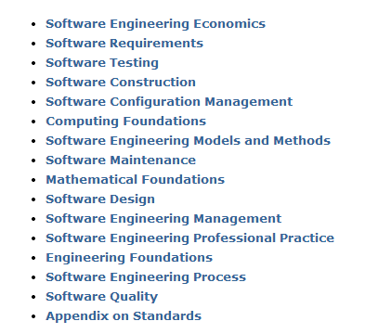
Further Reading on “Requirements”
Software Engineering Body of Knowledge
www.swebok.org

